Slide 1






LIGHTSPEED
STUDENT DATA
REPORT
FOR NUEVA SCHOOL
PREPARED BY
OLEG ZASUKHA
Notes:
Greetings ladies and gentlemen, my name is Oleg Zasukha and i am a data scientist representing a copmany LightSpeed, Mr. Terry, the Principal of your educational establishment, invited me here today to speak to you all about a very urgent matter.

Slide 2


CONTENT
01
02
03
Problem
Data, Schema, Warehouse
Descriptive Statistics
04
05
06
Querying
Goal
Proposal
Notes:
Before we delve into it, here is a brief overview of what this meeting is going to be like:
1. First, i will adress the reason i am here, Then you'll see an overview of the data and its characteristics, then we'll move on to the procedures which i performed and the inferences that were generated and finally the proposal to get your marketing folks going in the right direction.

Slide 3




STATUS QUO
Trailing 5-year period:
Average test scores
Student enrolment rate
USA standing 3d best in the country-> 49th
-11%
-22%
Notes:
So lets review the status quo:
Over the course of last 5 years, the average test scores, at your school, dropped: by staggering 11%, new student enrolment rate dropped by 22% and the school went down 46 positions in ranking. Dire situation, no doubt. but that is exactly why your new Principal mr. Terry hired LightSpeed and myself.

Slide 4


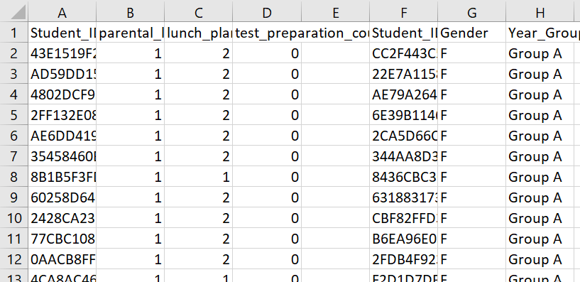
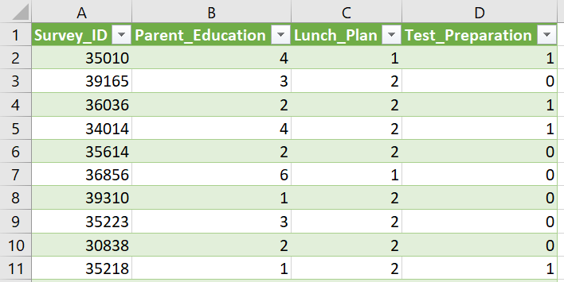
Data Preparation
Raw
Transformed
Notes:
So let me show what i got for you..
here is the transformation that we've performed on your raw student data.
In the original data, each of the three given tables was linked through studetnID column. Instead, i created primary keys for each of those tables and removed redundant studetnID columns.

Slide 5
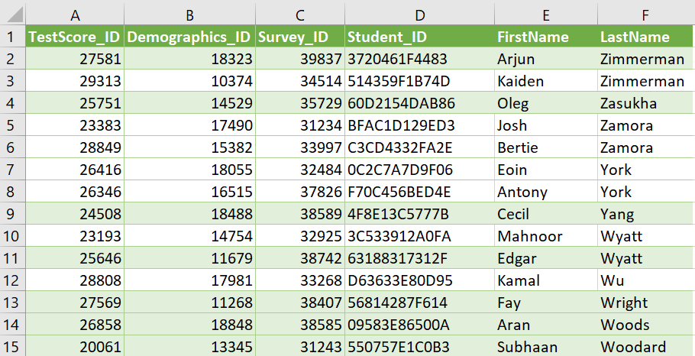
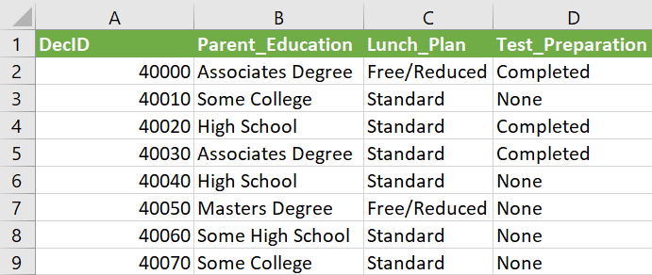
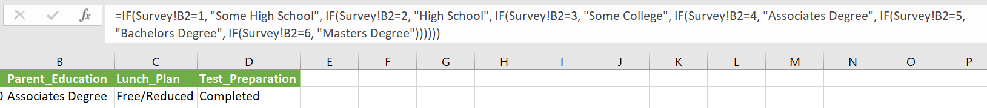
Preparation
Cont.
Table 2: Student
Table 1: Decoded
Notes:
Then i created 2 more tables which were necessary, the Decoded table - whcih contains the decoded values from the survey results and ofcourse the Student table. Later, we'll see how the student table became the pivot of our Star Schema.

Slide 6

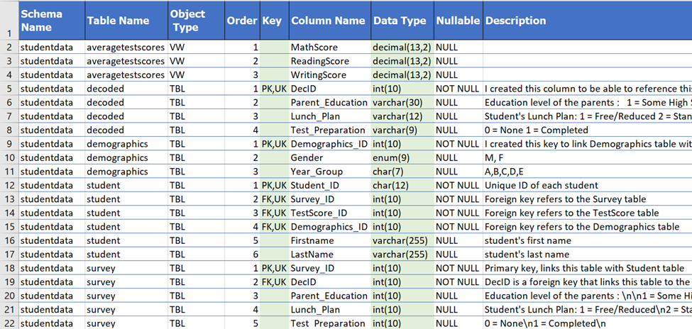
Data Dictionary
Notes:
And here you can see the data dictionary, with some of the tables, the referantial relationshps, column names and constraints and other things.

Slide 7


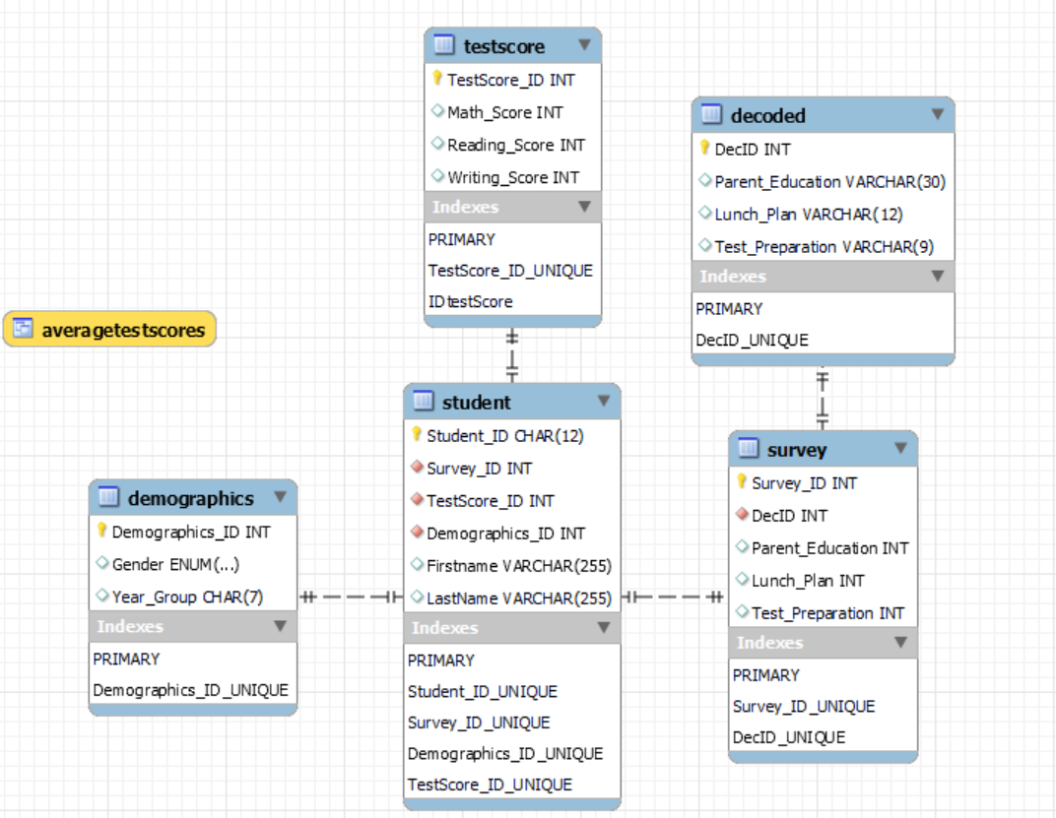
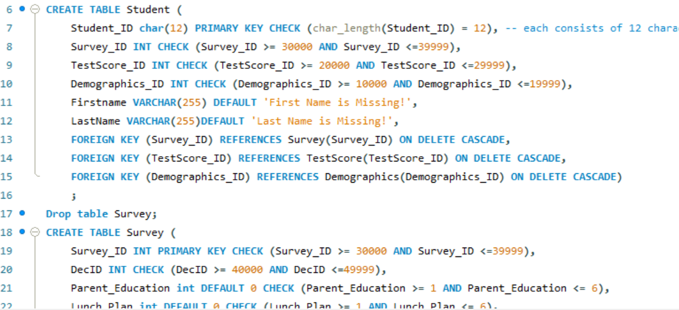
Star Schema
Notes:
This is how i created a database in MYSQL and the starSchema. So as i previously mentioned, the student table is the central point that references the dimension tables. it contains all the foreign keys with the use of which we can query our database.

Slide 8

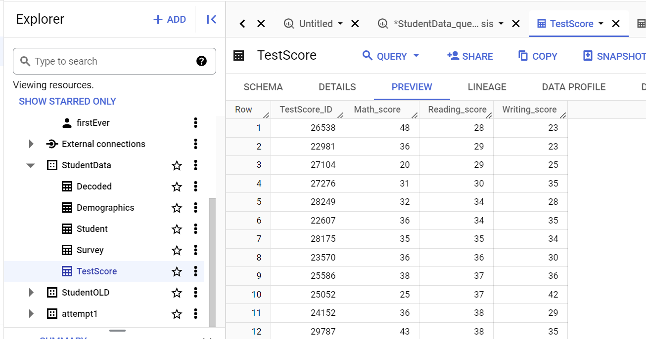
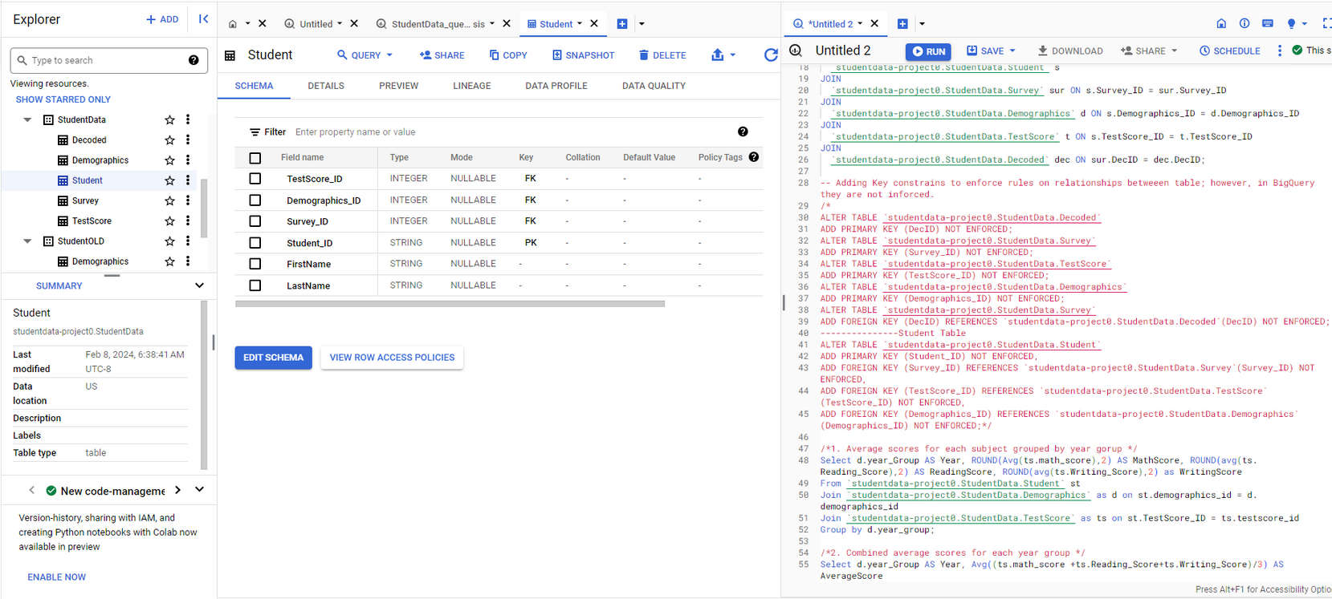
BigQuery Warehouse
StudentData dataset with 5 tables
Notes:
Sequentionally, i created a warehouse in bigquery to analyze our StudentData database. Here are examples of two tables that are in it, TestScore table and Student table.

Slide 9




Descriptive Statistics | BigQuery
Analysis
Notes:
Now we get to the fun part, the analysis that i've conducted.

Slide 10
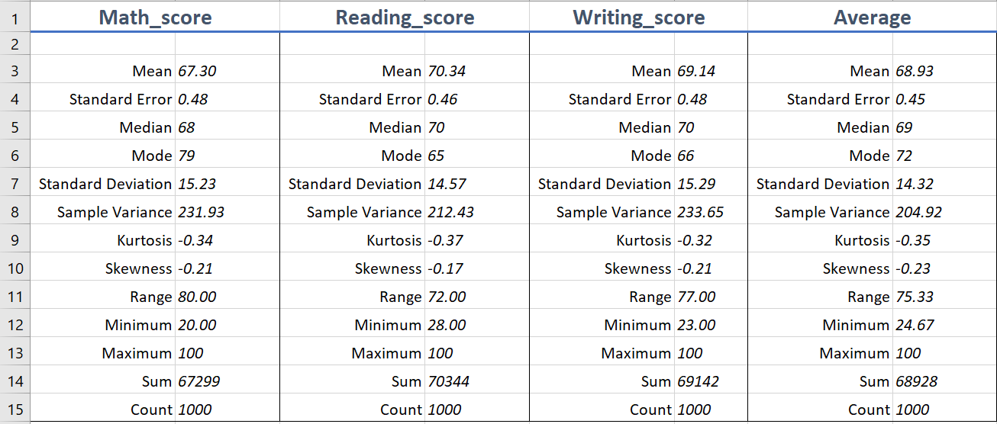


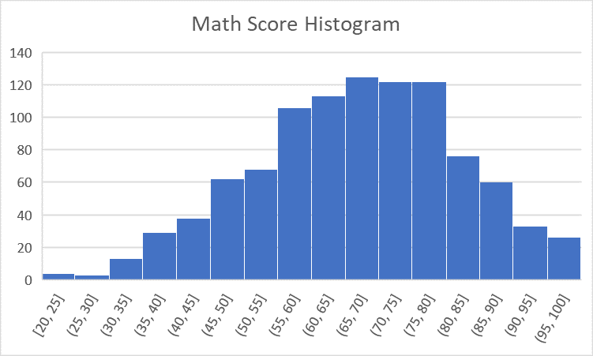
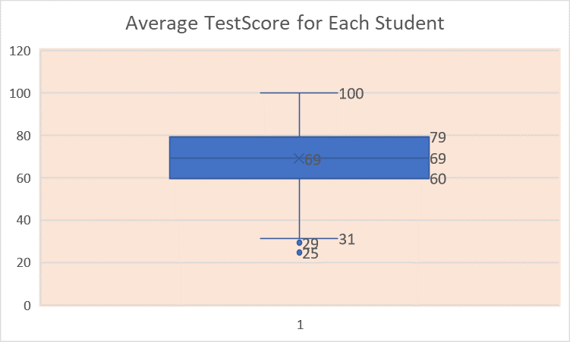

Descriptive
Statistics
Notes:
The first image shows a histogram of the math scores, and although there is a tiny skewness to the left, it must certainly is a normal distribution. In fact, the distributon for the other two subjects was normal as well.
On the second image there is a box and whicker plot which shows outliers in the data. Since we do not know the context behind them, i assumed that they were naturally occuring so i left them there.
Then the third table shows some of the discriptive stats of our data. The average column contains the average of all three subjects, the mean was 68.9% and the standard deviation 14.2 points.

Slide 11
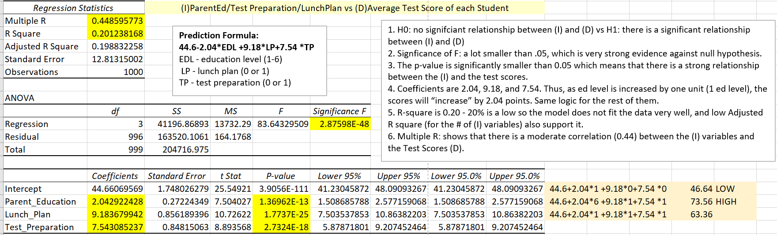
Descriptive
Statistics
Notes:
I also did a regresion analysis of your data, i wont get into all the details, but jsut a few key points:
1. there is a relationship between our independant variables and the dependant variable,
2. and there is a moderate positive correlation between the variables and the Test Scores.
3. final point, based on the regression model The Standard lunch results in 9 point increase in test scores and test preparation leads to 7.5 points increase.
And you can see the prediction formula right here.

Slide 12

GCP: BigQuery
Notes:
Now on to BigQuery analysis.

Slide 13

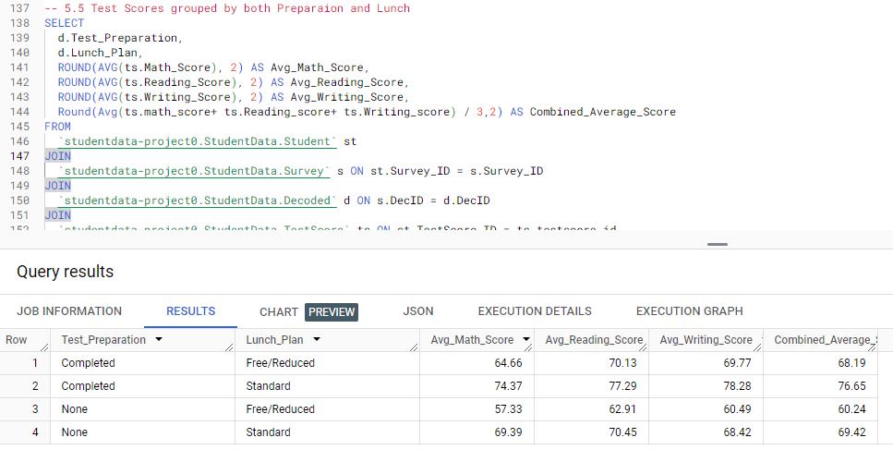
Test Scores:
Grouped by Preparation AND Lunch Type
Notes:
The first query that you see are the test scores grouped by preparation and lunch. One thing to note here, is that students who completed test preparation and had Standard lunch, averaged about 74% on the test scores, while those who did not complete the preparation and had reduced lunch, only averaged 57%.
That is a staggering 17% difference.

Slide 14

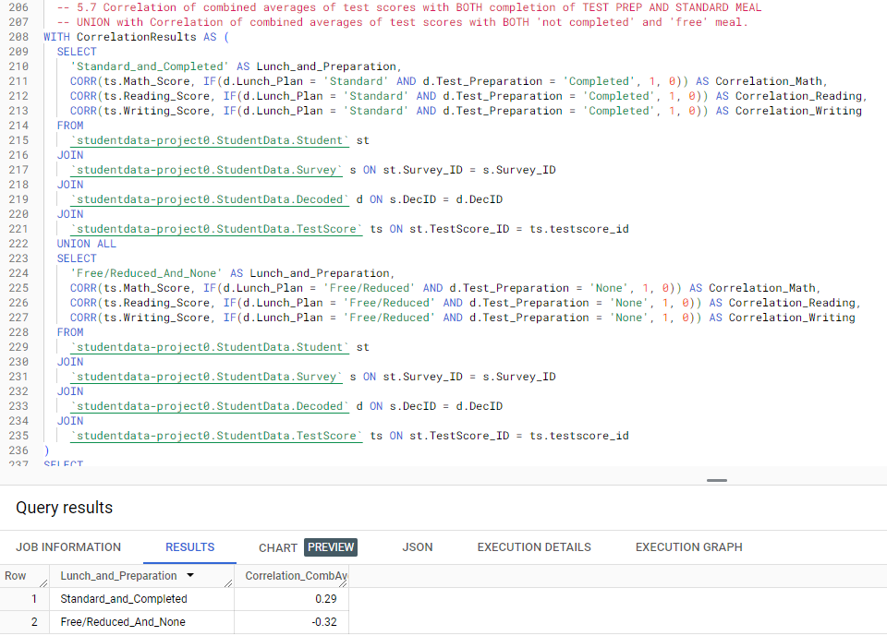

Correlation:
Notes:
For the next 2 queries, i will actually do a little demonstration:
here we got Correlation Analysis:
5.7 This query shows the correlation of combined averages of test scores with BOTH completion of TEST PREP AND STANDARD MEAL in UNION with Correlation of combined averages of test scores with BOTH 'Free/Reduced' and 'free' meal.
0.29 inidcates a moderate postive relationship which means that standard lunch and completed prep result in increase in test scores, and - 0.32 indicates a moderate negative relationship which leads to a decrease in test scores.

Slide 15
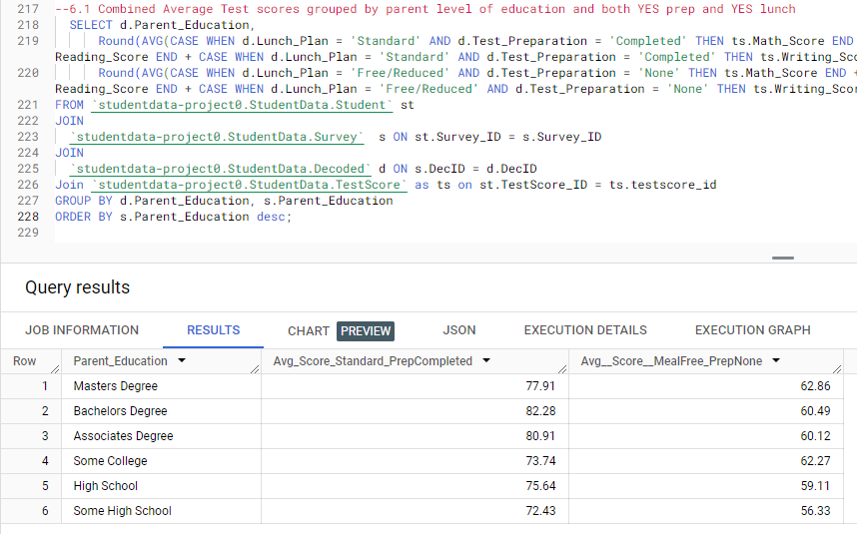
Test Scores:
Combined, average, test scores
Grouped by parent level of education
With TestPrep and Lunch Type as conditions
Notes:
Last query that i will show here is the
6.1 Combined Average Test scores grouped by parent level of education with conditions where both Standard Lunch and Completed Preparation vs NONE and FREE.
Looking at the results, its clear that Across all education levels, students generally perform better when they have a 'Standard' lunch plan and have completed test preparation.
There is a general trend of higher average scores as the parent's education level increases. With the largest difference of over 21% for the holders of Bachelors degrees.
Lets get back to the presenation now:

Slide 16

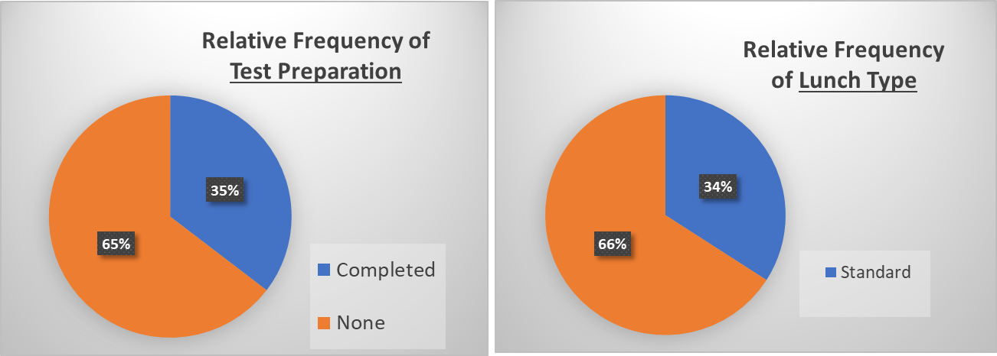
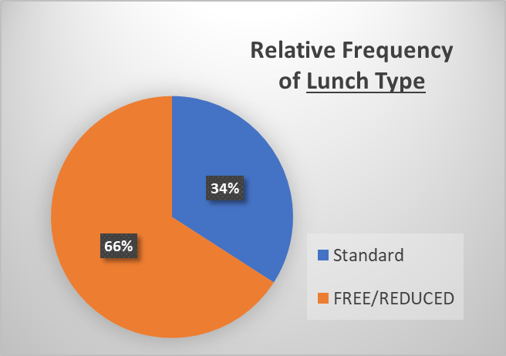
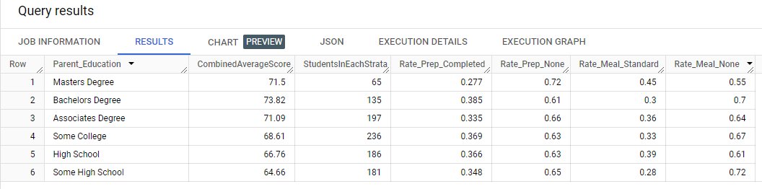
Frequency:
Only 35% completed test prep
Only 34% purchased standard lunch
Notes:
One more thing i want to show you are the relative frequencies of preparation and lunch.
We can see that only 35% of students completed preparation and only 34% purchased standard lunch.
And if we run a query and group the results by parent education levels, we can also see the rates are pretty low across all educaiton levels.

Slide 17




RESULTS OVERVIEW
Moderate, positive, correlation between lunch plan/test preparation and test scores.
The relationship between the (I) and (D) variables is statistically significant.
On average, students who completed test prep and had standard lunch, scored 16% higher than those who did not complete test prep and had reduced lunch.
Notes:
Before expressing my proposals, to increase the fortunes of your school, lets quickly reiterate the key points of the findings:
1. there is a moderate positive correlation between the Lunch plan, test prep, and the test scors.
2. The relationship between the variables is statistically significant
3. On average, students who completed test prep and had standard lunch scored 16% higher than those who did not complete test prep and had reduced lunch.

Slide 18



PROPOSALS
Importance of standard meals for lesser-educated parents: at the moment only 28% purchase standard meals
Advertise test prep. with emphasis on holders of associate degree or lower; the rates are under 37%
Notes:
Of course, it is now obvious that we need to increase our emphasis on promoting the purchase of standard meals and the importance of test preparations.
The increase in this two variables would positively affect the test results and lead to improved school standing.
Two specific suggestions that i would like to make for your markeitng team are:
1. We stress the importance of standard meals for lesser educated parents - they are a big stratum - yet only 28% of them buy standard meals
2. Second, we must improve the promotion of the test preparations with emphasis on parents who hold associate degreee or lower, since they represent a very large chunk of parent population, yet the test prep is under 37%. This way we will be able to quickly improve test scores and consequently improve the fortunes of our school

Slide 19

2024
LIGHTSPEED
LIGHTSPEED TO YOU ALL!
OLEG ZASUKHA
Notes:
This concludes my presentation, and im certain that together will not just changes the future of your school, but also positively influence the future of many children and those whom they affect in their life times. LIGHT SPEED TO YOU ALL! Thank you!

